Slide 1
Week 4 Development 6a - Algoritmiek
INFDEV016A
Giulia Costantini
costg@hr.nl – Office H4.204

Slide 2
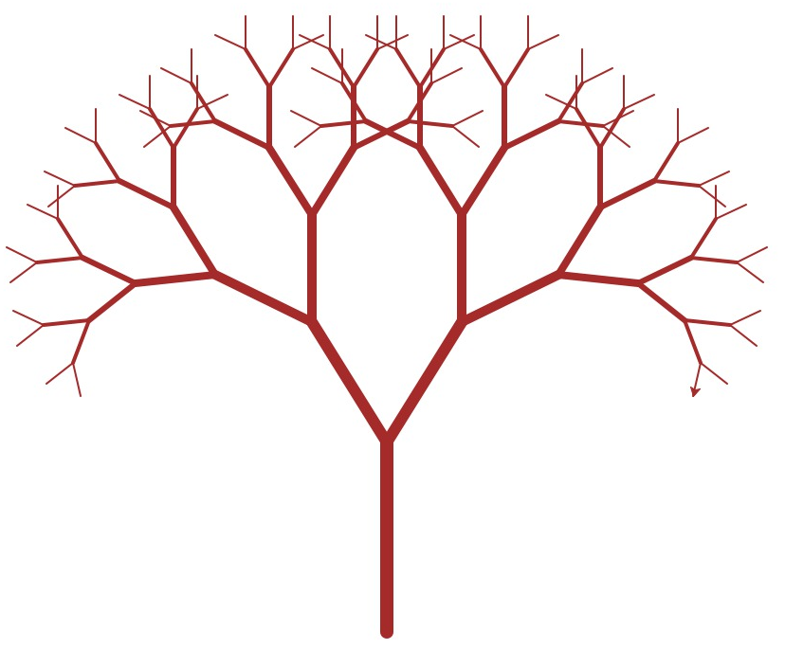
Today
Arrays
Complexity theory
Sorting algorithms
Lists
Stacks & Queues
Binary trees
Hash tables
Graphs
BINARY TREES

Slide 3
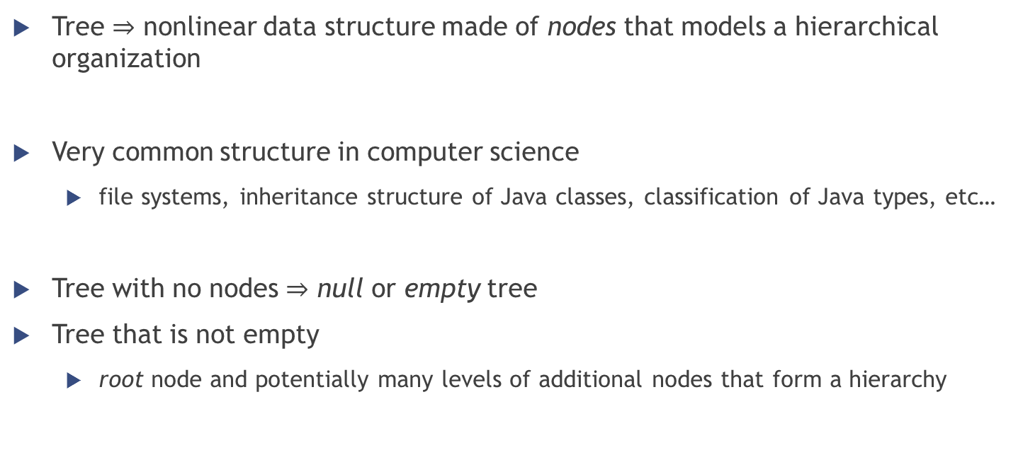
Tree definition
Tree $⇒$ nonlinear data structure made of nodes that models a hierarchical organization
Very common structure in computer science
file systems, inheritance structure of Java classes, classification of Java types, etc…
Tree with no nodes $⇒$ null or empty tree
Tree that is not empty
root node and potentially many levels of additional nodes that form a hierarchy

Slide 4
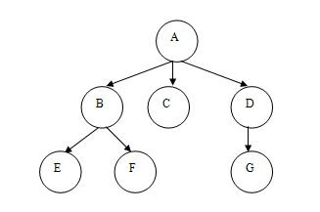
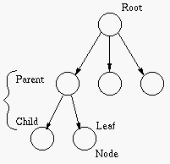
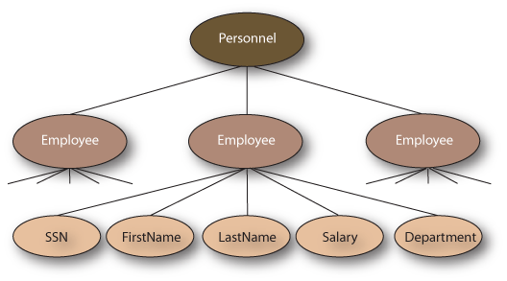
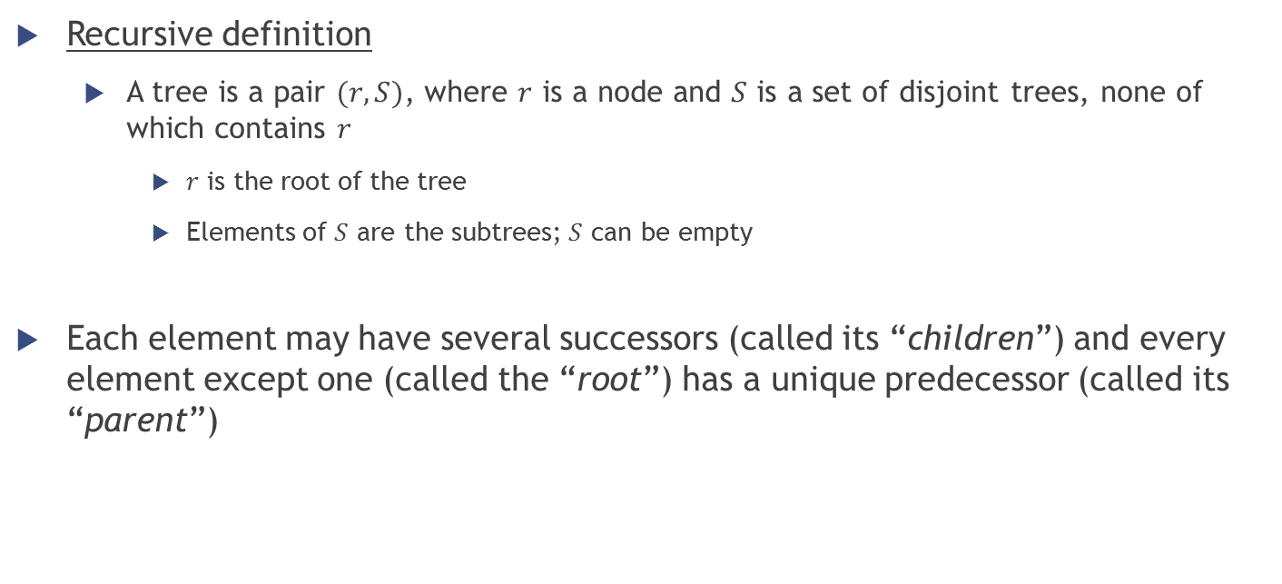
Tree definition
Recursive definition
A tree is a pair $(r, S)$, where $r$ is a node and $S$ is a set of disjoint trees, none of which contains $r$
$r$ is the root of the tree
Elements of $S$ are the subtrees; $S$ can be empty
Each element may have several successors (called its “children”) and every element except one (called the “root”) has a unique predecessor (called its “parent”)

Slide 5
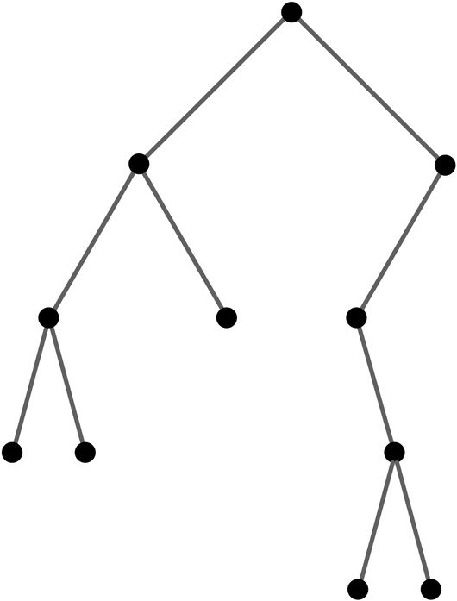
Binary Trees

Slide 6
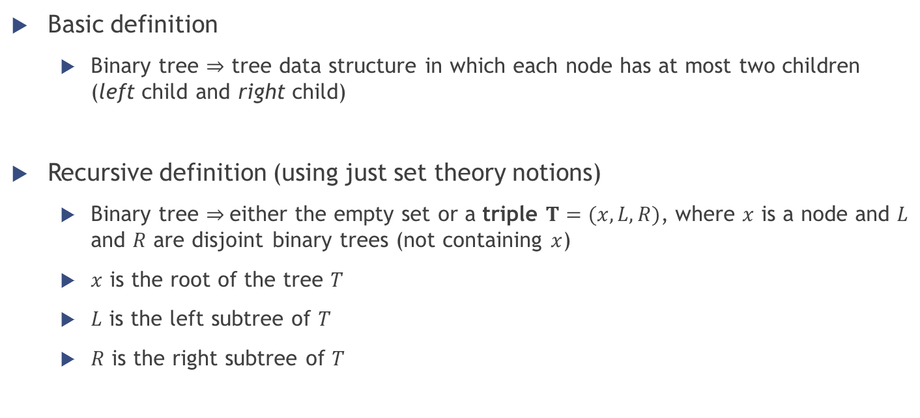
Binary tree definition
Basic definition
Binary tree $⇒$ tree data structure in which each node has at most two children (left child and right child)
Recursive definition (using just set theory notions)
Binary tree $⇒$either the empty set or a triple $T=(x, L, R)$, where $x$ is a node and $L$ and $R$ are disjoint binary trees (not containing $x$)
$x$ is the root of the tree $T$
$L$ is the left subtree of $T$
$R$ is the right subtree of $T$

Slide 7
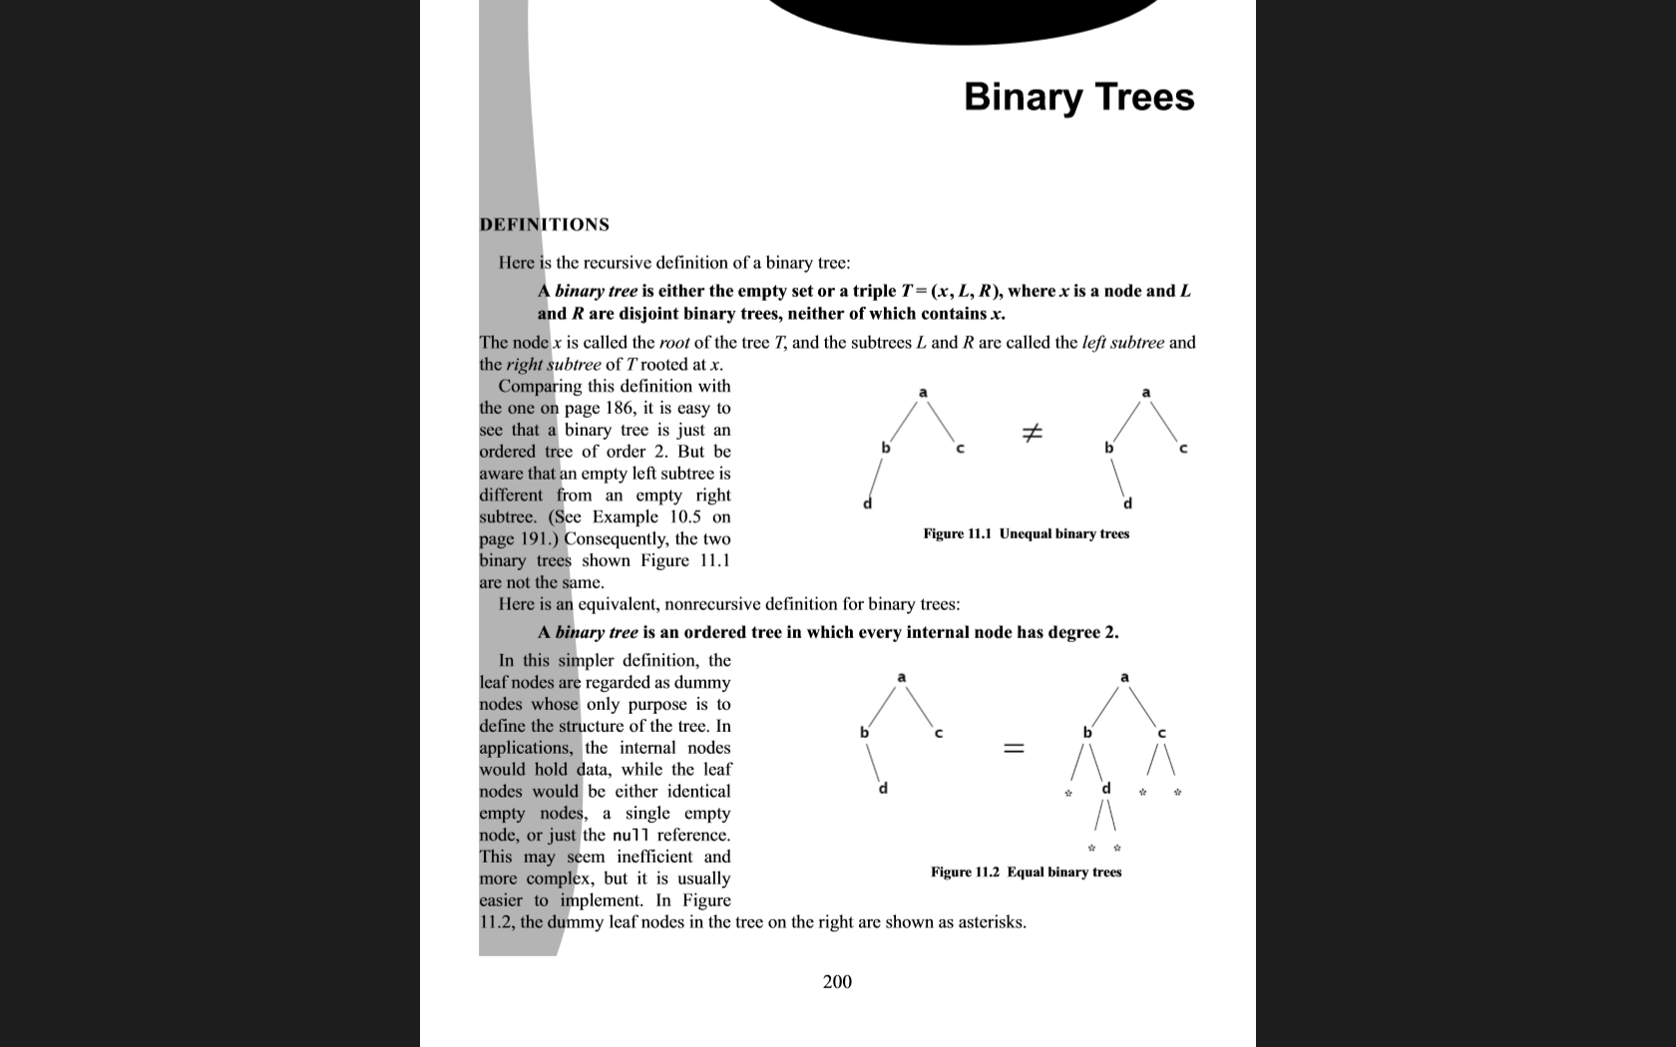
Binary trees examples
Unequal binary trees
Equal binary trees

Slide 8
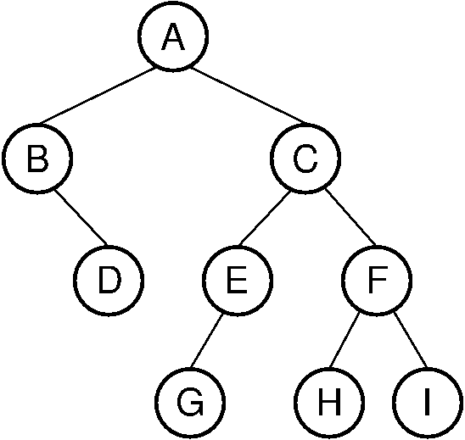
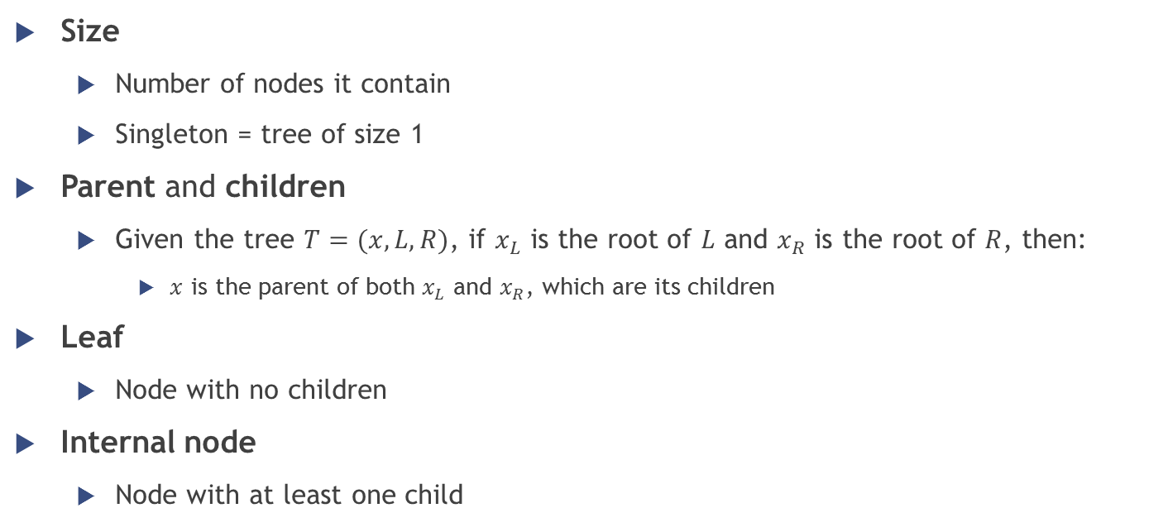
Binary trees properties (1/3)
Size
Number of nodes it contain
Singleton = tree of size 1
Parent and children
Given the tree $T=(x,L,R)$, if $x_{L}$ is the root of $L$ and $x_{R}$ is the root of $R$, then:
$x$ is the parent of both $x_{L}$ and $x_{R}$, which are its children
Leaf
Node with no children
Internal node
Node with at least one child

Slide 9
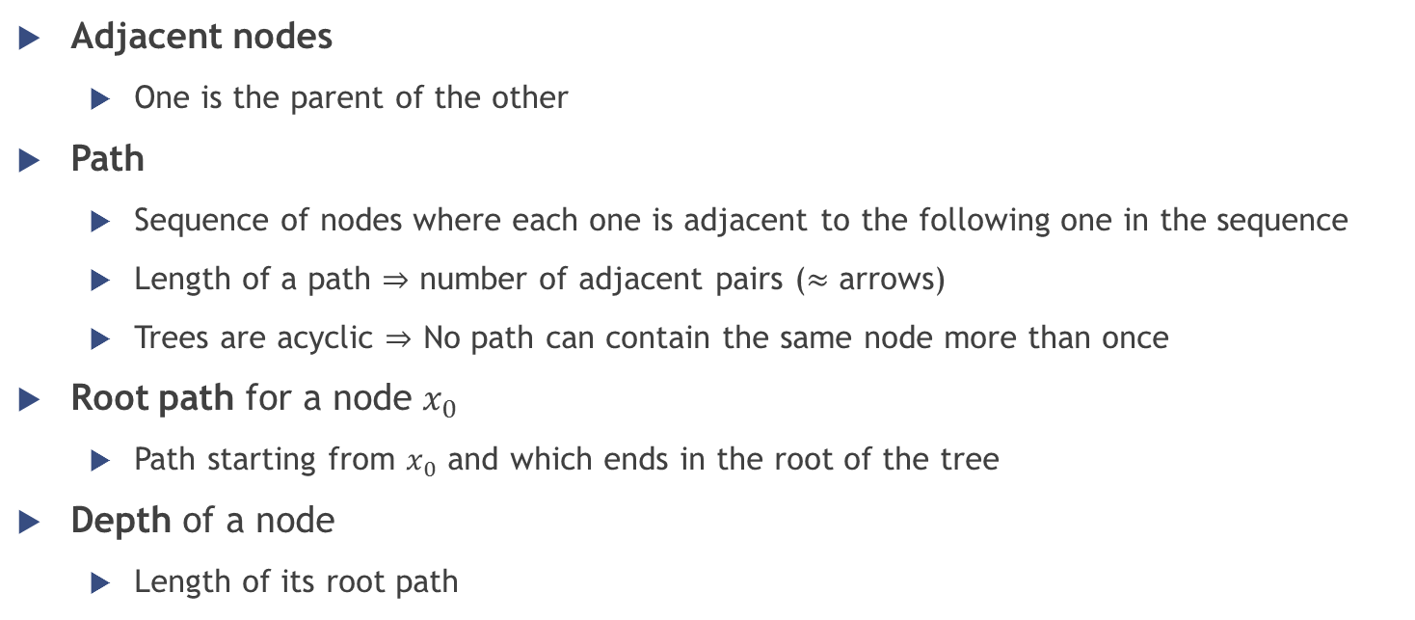
Binary trees properties (2/3)
Adjacent nodes
One is the parent of the other
Path
Sequence of nodes where each one is adjacent to the following one in the sequence
Length of a path $⇒$ number of adjacent pairs ($≈$ arrows)
Trees are acyclic $⇒$ No path can contain the same node more than once
Root path for a node $x_{0}$
Path starting from $x_{0}$ and which ends in the root of the tree
Depth of a node
Length of its root path

Slide 10
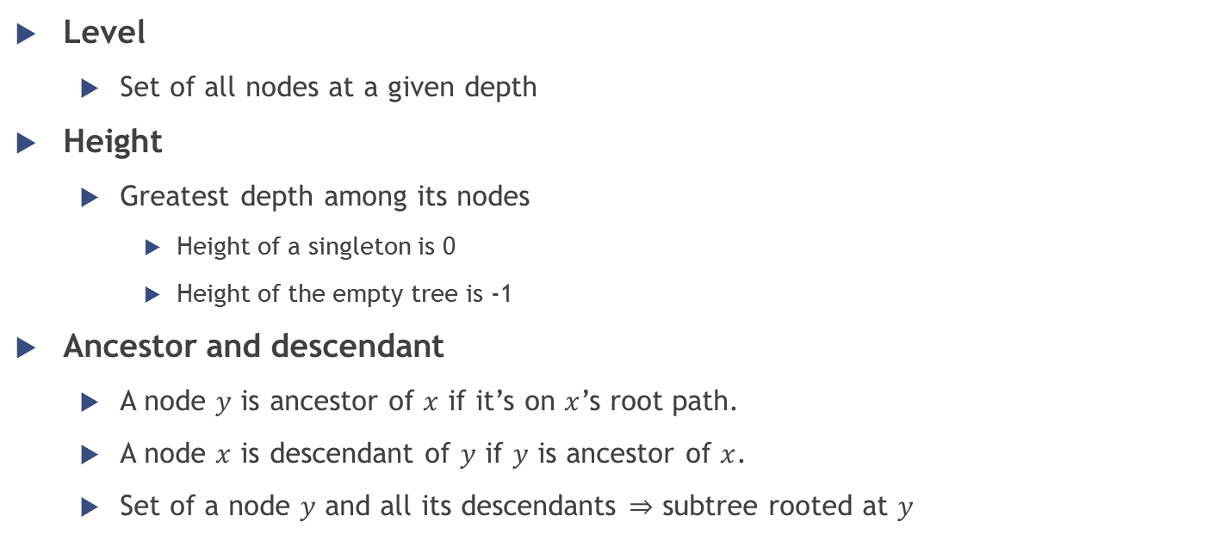
Binary trees properties (3/3)
Level
Set of all nodes at a given depth
Height
Greatest depth among its nodes
Height of a singleton is 0
Height of the empty tree is -1
Ancestor and descendant
A node $y$ is ancestor of $x$ if it’s on $x$’s root path.
A node $x$ is descendant of $y$ if $y$ is ancestor of $x$.
Set of a node $y$ and all its descendants $⇒$ subtree rooted at $y$

Slide 11
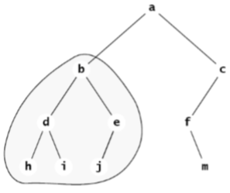

Binary trees properties – Example
Size?
10
Height?
3
Root node?
a
Path $(a,b,e,i)$ is valid?
No

Slide 12

Binary trees properties – Example
Path $(a,b,d)$ is valid?
Yes. Length of the path?
2
Level 2 of the tree?
$\{ d, e, f \}$
Depth of node $c$?
1
Subtree rooted at $c$?
$c→f→m$

Slide 13
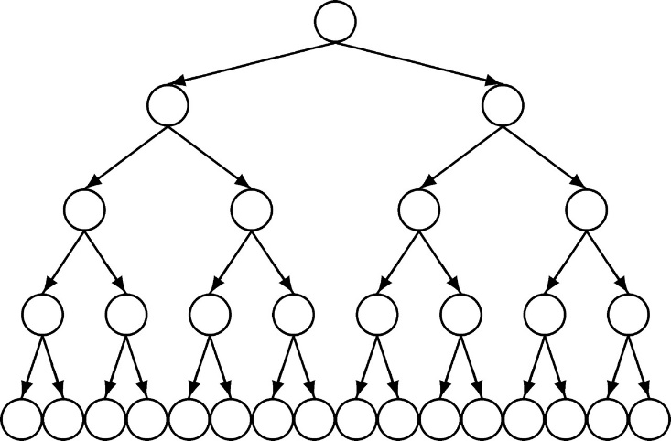
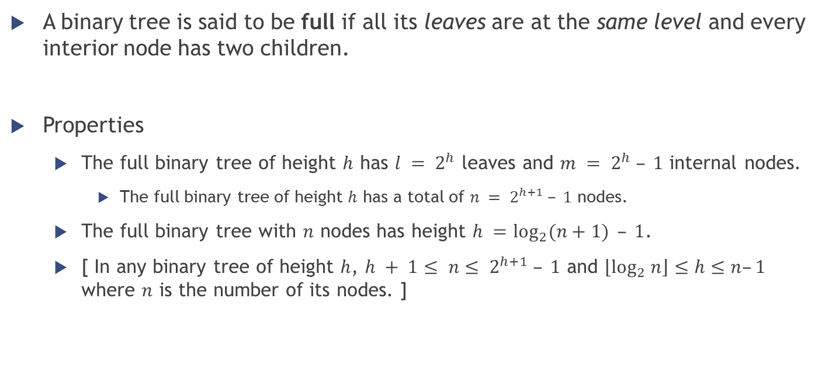
Full binary trees
A binary tree is said to be full if all its leaves are at the same level and every interior node has two children.
Properties
The full binary tree of height $h$ has $l = 2^{h}$ leaves and $m = 2^{h} – 1$ internal nodes.
The full binary tree of height $h$ has a total of $n = 2^{h+1} – 1$ nodes.
The full binary tree with $n$ nodes has height $h =\log_{2}{(n+1)}⁡ – 1$.
[ In any binary tree of height $h$, $h + 1≤ n≤ 2^{h+1} – 1$ and $\left\lfloor \log_{2} n\right\rfloor ≤h≤n–1$ where $n$ is the number of its nodes. ]

Slide 14
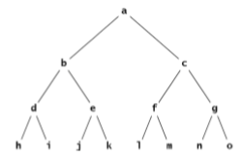
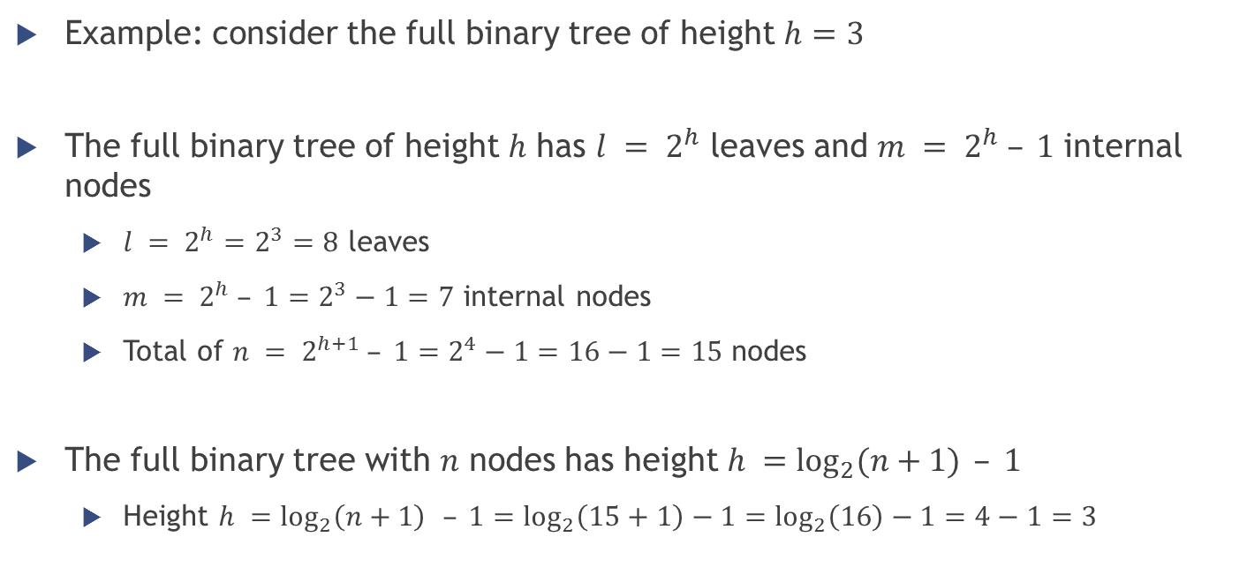
Full binary trees
Example: consider the full binary tree of height $h=3$
The full binary tree of height $h$ has $l = 2^{h}$ leaves and $m = 2^{h} – 1$ internal nodes
$l = 2^{h}=2^{3}=8$ leaves
$m = 2^{h} – 1=2^{3}−1=7$ internal nodes
Total of $n = 2^{h+1} – 1=2^{4}−1=16−1=15$ nodes
The full binary tree with $n$ nodes has height $h =\log_{2}{(n+1)}⁡ – 1$
Height $h =\log_{2}\left(n+1\right){ }– 1=\log_{2}\left(15+1\right)−1=\log_{2}\left(16\right)−1=4−1=3$

Slide 15
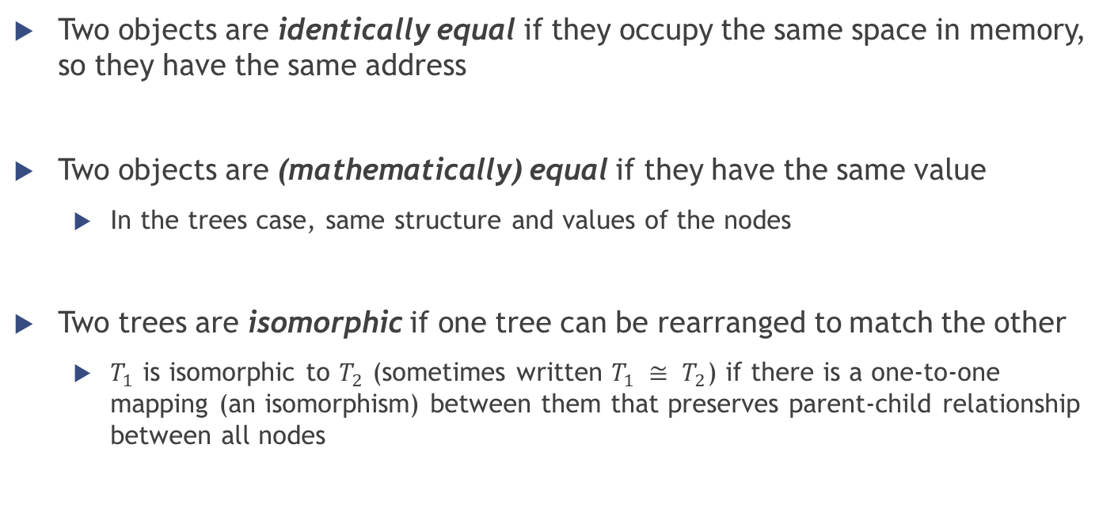
Binary tree comparison
Two objects are identically equal if they occupy the same space in memory, so they have the same address
Two objects are (mathematically) equal if they have the same value
In the trees case, same structure and values of the nodes
Two trees are isomorphic if one tree can be rearranged to match the other
$T_{1}$ is isomorphic to $T_{2}$ (sometimes written $T_{1} ≅ T_{2}$) if there is a one-to-one mapping (an isomorphism) between them that preserves parent-child relationship between all nodes

Slide 16
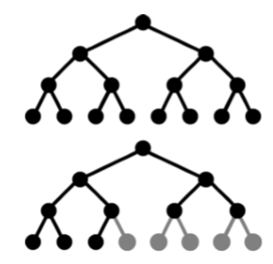
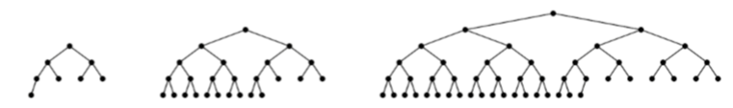
Complete binary trees
Important because they can be stored very simply in an array
Definition: either a full binary tree or one that is full except for a segment of missing leaves on the right side of the bottom level

Slide 17
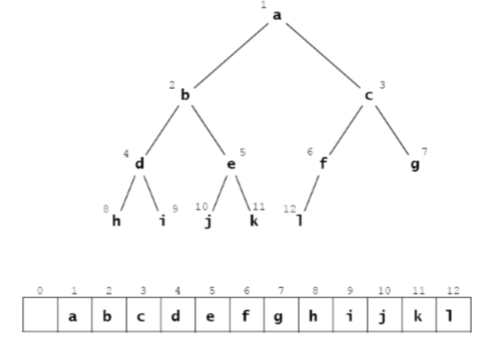
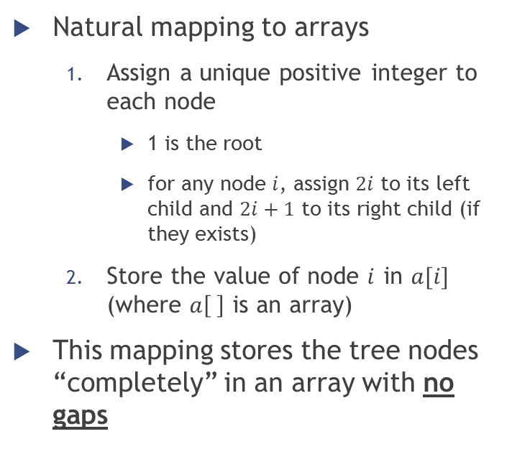
Complete binary trees
Natural mapping to arrays
Assign a unique positive integer to each node
1 is the root
for any node $i$, assign $2i$ to its left child and $2i+1$ to its right child (if they exists)
Store the value of node $i$ in $a[i]$ (where $a\left[ \right]$ is an array)
This mapping stores the tree nodes “completely” in an array with no gaps
Notes:
http://www.algolist.net/Data_structures/Binary_heap/Array-based_int_repr

Slide 18
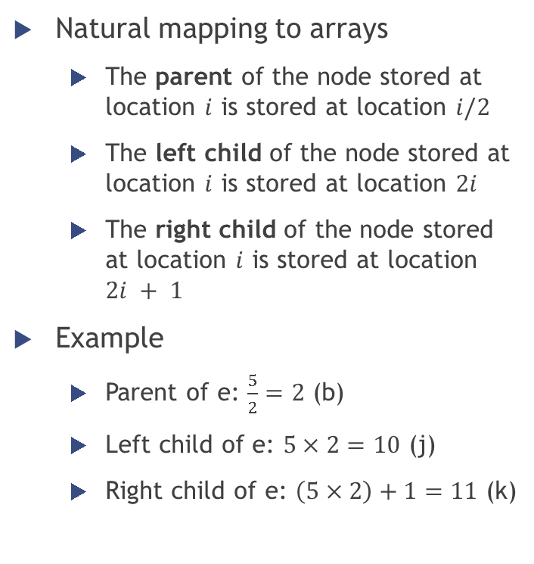
Complete binary trees
Natural mapping to arrays
The parent of the node stored at location $i$ is stored at location $i/2$
The left child of the node stored at location $i$ is stored at location $2i$
The right child of the node stored at location $i$ is stored at location $2i + 1$
Example
Parent of e: $\frac{5}{2}=2$ (b)
Left child of e: $5×2=10$ (j)
Right child of e: $\left(5×2\right)+1=11$ (k)

Slide 19
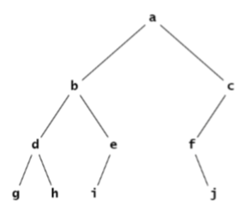

Incomplete binary trees
Using the same mapping on an incomplete binary tree…
Gaps in the array!

Slide 20
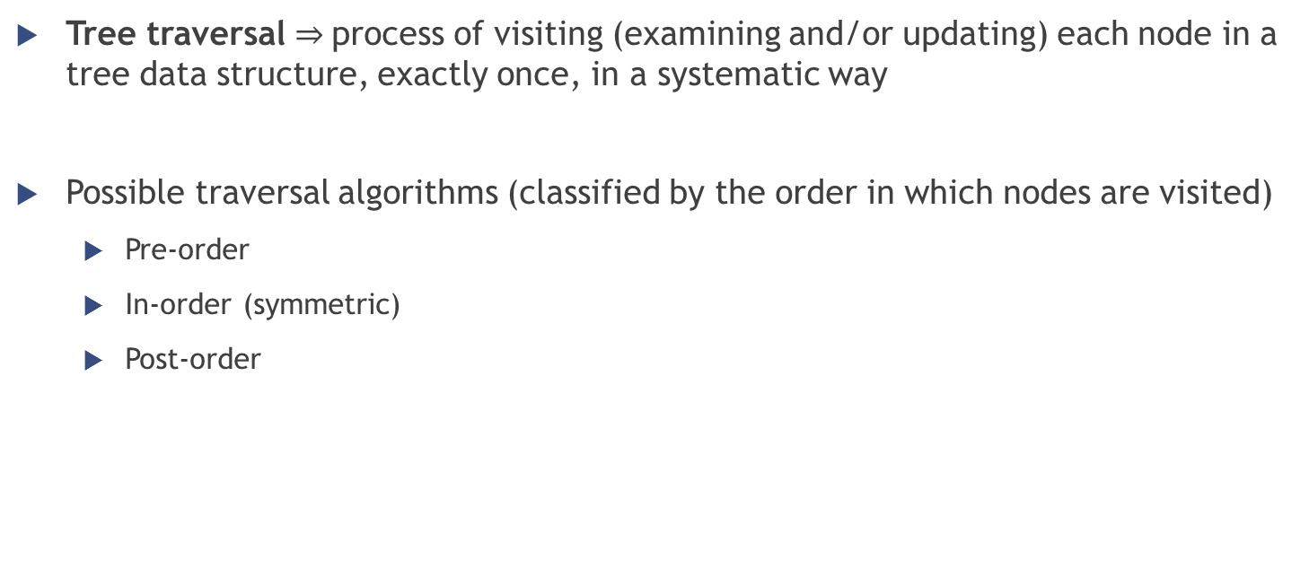
Traversing a binary tree
Tree traversal $⇒$process of visiting (examining and/or updating) each node in a tree data structure, exactly once, in a systematic way
Possible traversal algorithms (classified by the order in which nodes are visited)
Pre-order
In-order (symmetric)
Post-order

Slide 21
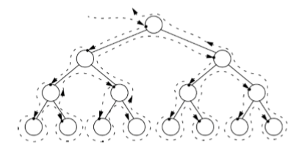
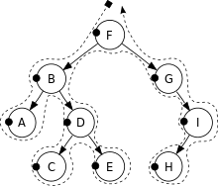
Traversing a binary tree
Pre-order
Visit the root
Traverse the left subtree
Traverse the right subtree
In-order
Traverse the left subtree
Visit the root
Traverse the right subtree
Post-order
Traverse the left subtree
Traverse the right subtree
Visit the root
Pre-order: F, B, A, D, C, E, G, I, H

Slide 22
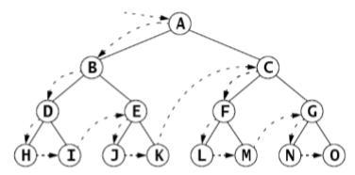
Traversing a binary tree
Pre-order
Visit the root
Traverse the left subtree
Traverse the right subtree
In-order
Traverse the left subtree
Visit the root
Traverse the right subtree
Post-order
Traverse the left subtree
Traverse the right subtree
Visit the root

Slide 23
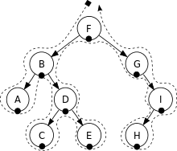
Traversing a binary tree
Pre-order
Visit the root
Traverse the left subtree
Traverse the right subtree
In-order
Traverse the left subtree
Visit the root
Traverse the right subtree
Post-order
Traverse the left subtree
Traverse the right subtree
Visit the root
In-order: A, B, C, D, E, F, G, H, I

Slide 24
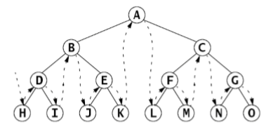
Traversing a binary tree
Pre-order
Visit the root
Traverse the left subtree
Traverse the right subtree
In-order
Traverse the left subtree
Visit the root
Traverse the right subtree
Post-order
Traverse the left subtree
Traverse the right subtree
Visit the root

Slide 25

Traversing a binary tree
Pre-order
Visit the root
Traverse the left subtree
Traverse the right subtree
In-order
Traverse the left subtree
Visit the root
Traverse the right subtree
Post-order
Traverse the left subtree
Traverse the right subtree
Visit the root
Post-order: A, C, E, D, B, H, I, G, F

Slide 26
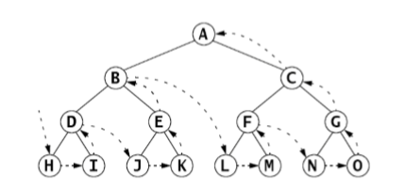
Traversing a binary tree
Pre-order
Visit the root
Traverse the left subtree
Traverse the right subtree
In-order
Traverse the left subtree
Visit the root
Traverse the right subtree
Post-order
Traverse the left subtree
Traverse the right subtree
Visit the root

Slide 27
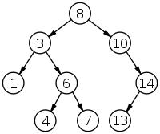
Traversing a binary tree
Exercise
Show the resulting sequence of numbers obtained by traversing the following binary tree using the following traversal algorithms
Preorder
Inorder
Postorder

Slide 28
Binary Search Trees

Slide 29
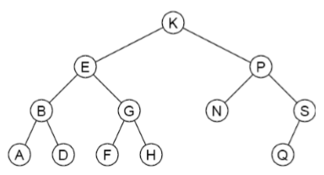

Binary search tree definition
A binary search tree is a binary tree whose elements include a key field of some ordinal type and which has this property:
If $k$ is the key value at any node, then $k≥ x$ for every key $x$ in the node’s left subtree and $k≤ y$ for every key $y$ in the node’s right subtree
Also called “BST property”

Slide 30
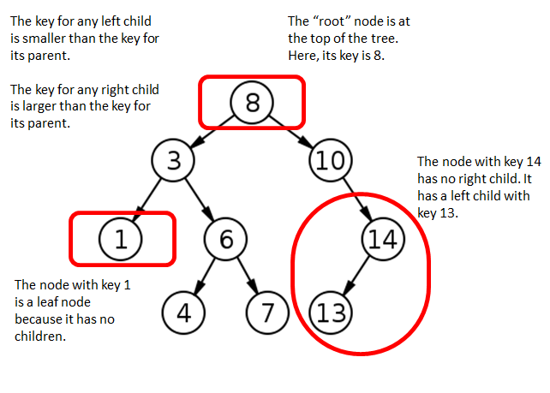
Binary search tree

Slide 31

Binary search tree property
Because of the BST property…
in-order traversal $⇒$ sorted sequence of elements in increasing order
$A, B, D,E, F, G, H, K, N, P, Q, S$ $1, 3, 4, 6, 7, 8, 10, 13, 14$

Slide 32
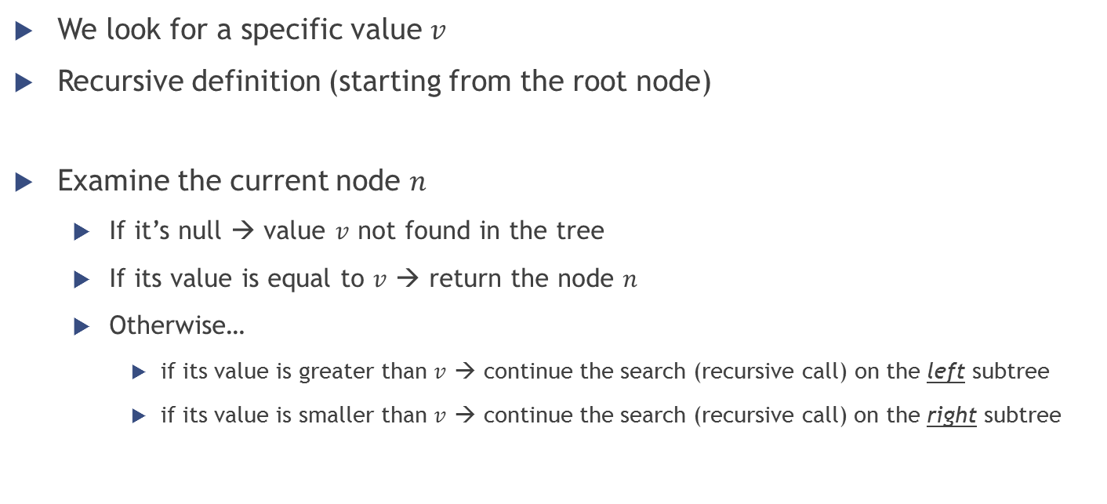
Binary search tree – Searching
We look for a specific value $v$
Recursive definition (starting from the root node)
Examine the current node $n$
If it’s null → value $v$ not found in the tree
If its value is equal to $v$ → return the node $n$
Otherwise…
if its value is greater than $v$ → continue the search (recursive call) on the left subtree
if its value is smaller than $v$ → continue the search (recursive call) on the right subtree

Slide 33
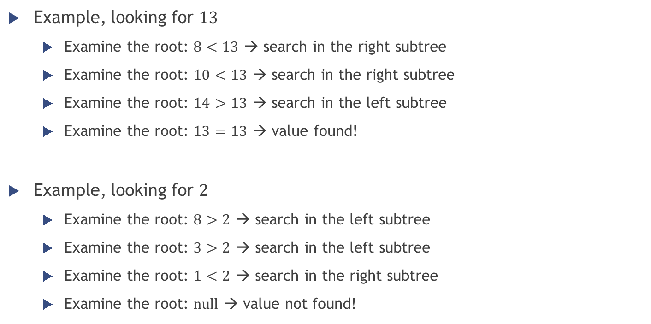
Binary search tree – Searching
Example, looking for $13$
Examine the root: $8<13$ → search in the right subtree
Examine the root: $10<13$ → search in the right subtree
Examine the root: $14>13$ → search in the left subtree
Examine the root: $13=13$ → value found!
Example, looking for $2$
Examine the root: $8>2$ → search in the left subtree
Examine the root: $3>2$ → search in the left subtree
Examine the root: $1<2$ → search in the right subtree
Examine the root: $null$ → value not found!

Slide 34
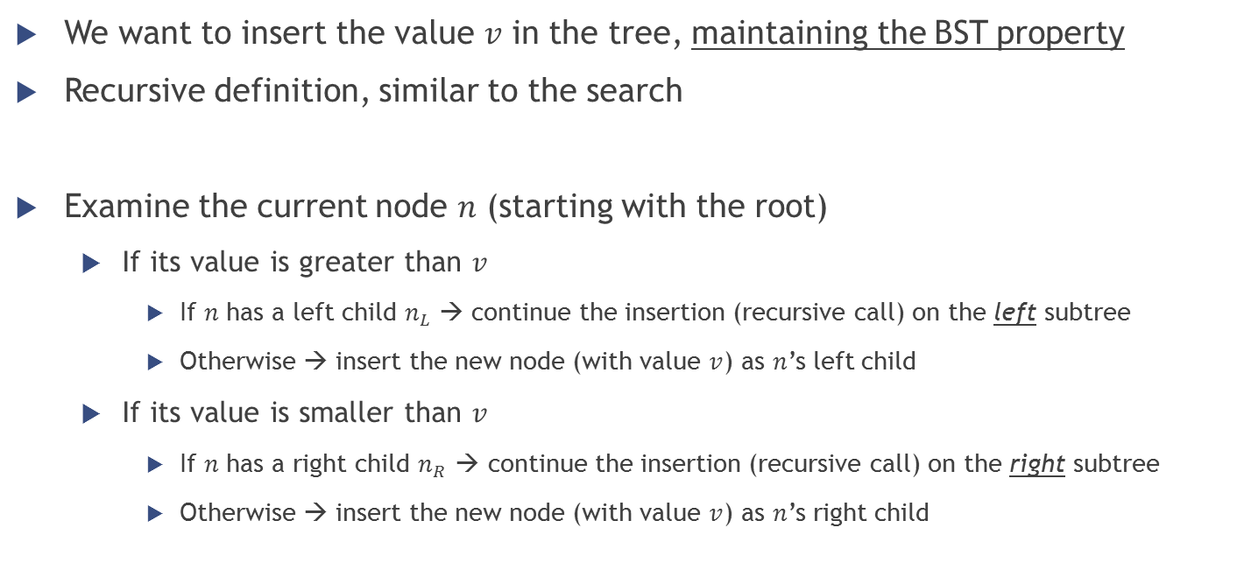
Binary search tree – Insertion
We want to insert the value $v$ in the tree, maintaining the BST property
Recursive definition, similar to the search
Examine the current node $n$ (starting with the root)
If its value is greater than $v$
If $n$ has a left child $n_{L}$ → continue the insertion (recursive call) on the left subtree
Otherwise → insert the new node (with value $v$) as $n$’s left child
If its value is smaller than $v$
If $n$ has a right child $n_{R}$ → continue the insertion (recursive call) on the right subtree
Otherwise → insert the new node (with value $v$) as $n$’s right child

Slide 35
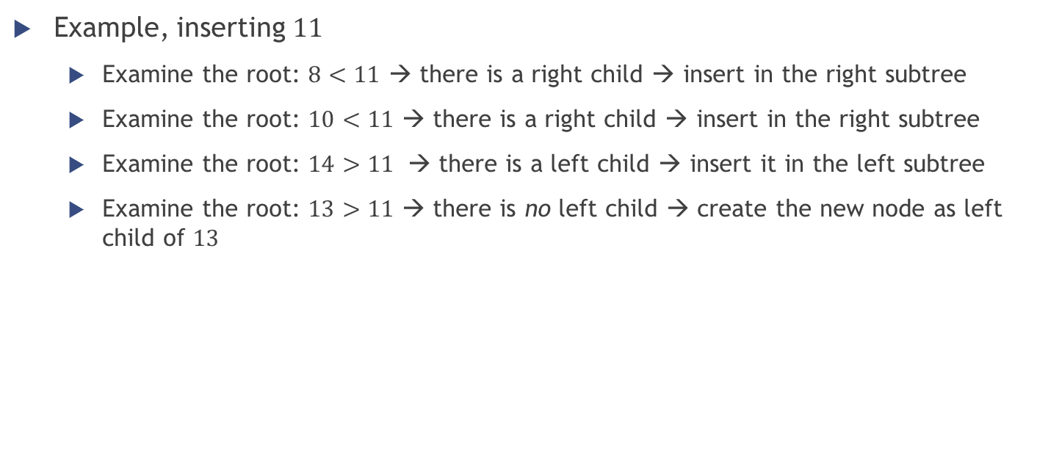
Binary search tree – Insertion
Example, inserting $11$
Examine the root: $8<11$ → there is a right child → insert in the right subtree
Examine the root: $10<11$ → there is a right child → insert in the right subtree
Examine the root: $14>11$ → there is a left child → insert it in the left subtree
Examine the root: $13>11$ → there is no left child → create the new node as left child of $13$
11

Slide 36

Binary search tree – Insertion
Example, inserting $2$
Examine the root: $8>2$ → there is a left child → insert in the left subtree
Examine the root: $3>2$ → there is a left child → insert in the left subtree
Examine the root: $1<2$ → there is no right child → create the new node as right child of $1$
2

Slide 37
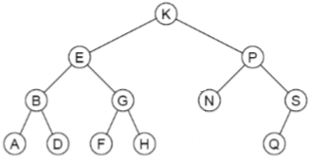
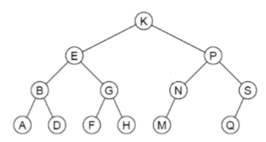

Binary search tree – Insertion
Example, inserting $M$
Examine the root: $K<M$ → there is a right child → insert in the right subtree
Examine the root: $P>M$ → there is a left child → insert in the left subtree
Examine the root: $N>M$ → there is no left child → create the new node as left child of $N$

Slide 38

Binary search tree – Insertion
Exercise
Given the following sequence of numbers, draw a binary search tree by inserting such numbers from left to right.
$$11, 6, 8, 19, 4, 10, 5, 17, 43, 49, 31$$

Slide 39
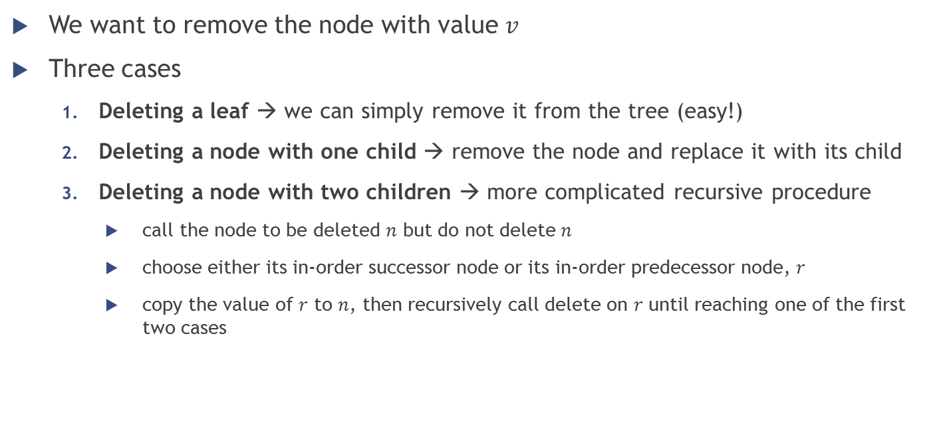
Binary search tree – Deletion
We want to remove the node with value $v$
Three cases
Deleting a leaf → we can simply remove it from the tree (easy!)
Deleting a node with one child → remove the node and replace it with its child
Deleting a node with two children → more complicated recursive procedure
call the node to be deleted $n$ but do not delete $n$
choose either its in-order successor node or its in-order predecessor node, $r$
copy the value of $r$ to $n$, then recursively call delete on $r$ until reaching one of the first two cases

Slide 40
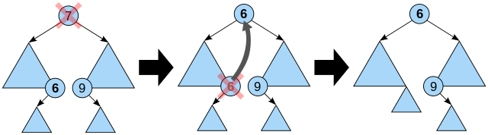
Binary search tree – Deletion
Smallest element of the right subtree
Case 3 (node with two children) is the most difficult
As with all binary trees…
a node's in-order successor is its right subtree's left-most child
a node's in-order predecessor is the left subtree's right-most child
Biggest element of the left subtree

Slide 41
Binary search tree – Deletion
Smallest element of the right subtree
Case 3 (node with two children) is the most difficult
As with all binary trees…
a node's in-order successor is its right subtree's left-most child
a node's in-order predecessor is the left subtree's right-most child
In either case, this node will have zero or one children. Delete it according to one of the two simpler cases.
Biggest element of the left subtree

Slide 42

Binary search tree – Deletion
Examples

Slide 43


Binary search tree – Deletion
Example, deleting $50$

Slide 44

Binary search tree – Deletion
Example, deleting 11

Slide 45

Binary search tree – Deletion
Exercise
Given the following sequence of numbers, draw a binary search tree by inserting such numbers from left to right and then show the two trees that can be the result after the removal of 11.
$$11, 6, 8, 19, 4, 10, 5, 17, 43, 49, 31$$

Slide 46


Binary search tree – Balanced vs unbalanced
Very efficient searching if a binary search tree is balanced
Without further restrictions, a binary search tree may grow to be very unbalanced
worst case when the elements are inserted in sorted order → the tree becomes almost linear
Inserting the input sequence
44, 22, 77, 55, 99, 88, 33
Inserting the input sequence
99, 22, 88, 33, 77, 55, 44

Slide 47


Binary search tree – Performance
Computational complexity of the operations
Insertion & searching → begin at the root of the tree and proceed down toward the leaves, making one comparison at each level of the tree
Deletion → this operation does not always traverse the tree down to a leaf, but it is always a possibility
… Thus, the time required to execute each algorithm is proportional to the height $h$ of the tree
Height of a binary search tree?
On average, binary search trees with $n$ nodes have $O(\log{n})$ height
In the worst case, binary search trees can have $O(n)$ height (the most unbalanced tree is like a linked list)
Operation | Average case | Worst case
Searching | $$O(\log{n})$$ | $$O(n)$$
Insertion | $$O(\log{n})$$ | $$O(n)$$
Deletion | $$O(\log{n})$$ | $$O(n)$$

Slide 48

Exercises
Draw the BST that results when you insert items with keys E A S Y Q U E S T I O N in that order into an initially empty tree
Draw the BST resulting from the insertion of the following keys (from left to right) into an initially empty tree:
$$keys = \{17, 9, 26, 12, 11, 7, 30, 20, 21, 10\}$$
Draw the BST after the key 17 is deleted
Notes:
http://andromeda.rutgers.edu/~loftin/datafal06/answers/practicehw3.pdf

Slide 49


Exercises
Determine the order in which the vertices of the following binary trees will be visited under
Preorder traversal
Inorder traversal
Postorder traversal
Notes:
First tree:
(1) preorder => 1,2,3,5,7,8,6,4
(2) inorder => 1,7,5,8,3,6,2,4
(3) postorder =>7,8,5,6,3,4,2,1
Second tree:
PreOrder - 8, 5, 9, 7, 1, 12, 2, 4, 11, 3 InOrder - 9, 5, 1, 7, 2, 12, 8, 4, 3, 11 PostOrder - 9, 1, 2, 12, 7, 5, 3, 11, 4, 8

Slide 50
Exercises
From Hubbard, Chapter 11
Review Questions 11.1, 11.2, 11.3, 11.4, 11.5, 11.6
Problems 11.2, 11.3, 11.4, 11.5, 11.6, 11.7
GO ON WITH (OR START) THE ASSIGNMENT!

Slide 51
BST in Java & .NET
http://msdn.microsoft.com/en-us/library/ms379572(v=vs.80).aspx
Java: TreeSet
http://docs.oracle.com/javase/6/docs/api/java/util/TreeSet.html
uses a balanced binary search tree to store its elements
C#: SortedSet
http://msdn.microsoft.com/en-us/library/dd412070.aspx
It is implemented using a self-balancing red-black tree that gives a performance complexity of O(log n) for insert, delete, and lookup. It is used to keep the elements in sorted order, to get the subset of elements in a particular range, or to get the Min or Max element of the set.

